Slide 1
What Is Science (Part 2)
Quantitatve Observation

Slide 2

Observation
Science begins with _______ observation.
Looking with a ______ and prior knowledge
Looking to see what is _________ there (not what you think should be there)
There are ______ types of observation in science.
Qualitative Observation (think __________)
Observing with your ___________ (e.g. sight, feel, etc.)
Quantitative Observation (think ___________)
______________ with devices (e.g. ruler, scale, etc.)

Slide 3
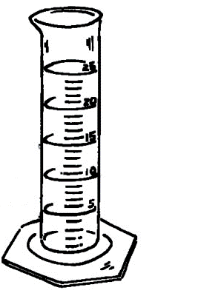
Quantitative Observation
Measured or calculated using lab _____________
Time (in ___________), using a ___________
Length (in ______), using a ___________
Mass (in ___________), using a ___________
Volume (in ______), using a ___________ ___________
Volume (in ______), ___________ = LxWxH
Carefully recording basic measurements
In a ________ _________ that is neat and well organized
Using multiple _________ to minimize measurement _________
Calculated using other basic measurements
For example: Density (in g/cm³) = _________ ÷ _________

Slide 4
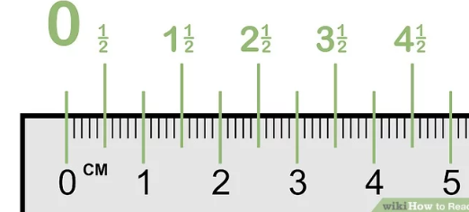
Measuring Length & Distance
Length is a measurement of the _________ of an object
We measure length using a _________ or _________ _________
Width & Height are _________ names for length
We measure length in centimeters (_____) and millimeters (_____)
1 cm = _______ mm
The length of the arrow is _________
Distance is the measurement of the movement of an object
We measure distance in _________ (m)
1 m = _______ cm
1 m = _______ mm

Slide 5
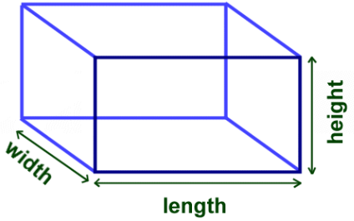
Calculated & Measured Volume
Volume may be calculated using a ___________
Volume = L x W x H
The unit for calculated volume is _______
Volume may be __________ using a graduated cylinder
The unit for measured volume in ____________ (ml)
1 ml = _______ cm³
Larger volumes are measured in ___________ (L)
1 L = _______ ml
1 L = _______ cm³

Slide 6
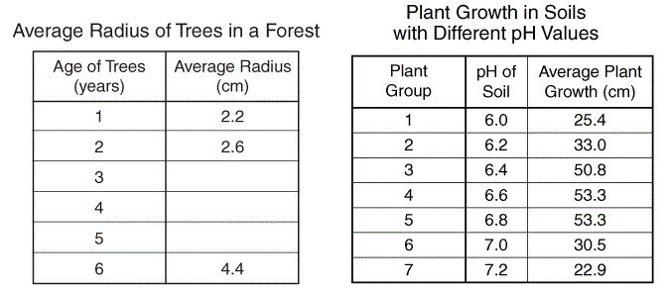
Recording Quantitative Measurements
Use a Data Table to _________ your measurements
Neatly organized and ___________ using a ruler
Make sure to include a descriptive _________
Column ___________ should include
Clear _____________ of what is being measured
________ (e.g. cm) for the measurement
New Row for each ________ ________ being measured
Descriptive Column Headings
New Row
For Each
Object

Slide 7
Recording Quantitative Measurements
Copy the following Data Table into your note
Calculate the volume for each object
Object | Length Measurement (± 0.1 cm) | Width Measurement (± 0.1 cm) | Height Measurement (± 0.1 cm) | Volume Calculation (LxWxH cm³)
Object #1
Object #2
Object #3

Slide 8
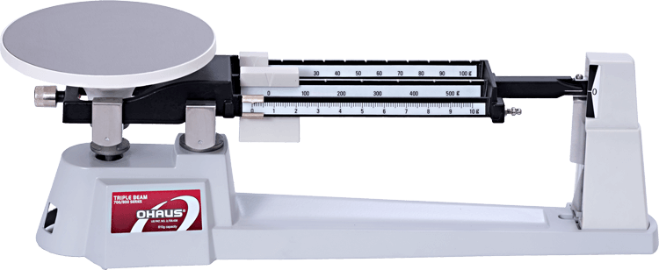
Measuring Mass
Mass is a measurement of the _________ of an object
We measure mass using a _________ beam balance
For small objects we measure mass in _________ (g)
For large objects we measure mass in ___________ (Kg)
1 Kg = ________ g
Weight is _______ the same as mass!
Weight depends on _________
Your weight _________ depending on where your are
You weigh less on the _________ than on Earth
You can be _____________ in space
Your mass _________ changes!
Mass depend on the _________ of atoms in your body

Slide 9
Using A Triple Beam Balance
Sliding Weights – Three Beams
____ g weight – adjusts 0g to 100g
____ g weight – adjusts 0g to 500g
____ g weight – adjusts 0g to 10g
Zero Pointer
Objective is to make it ________
If too high: Need to __________ sliding weight
If too low: Need to __________ sliding weight
Initial Calibration
Set ______ the weights to zero
With nothing on the balance
Make sure the Zero Pointer is at _________
If not zero, call your teacher
Zero Pointer
Sliding Weights

Slide 10
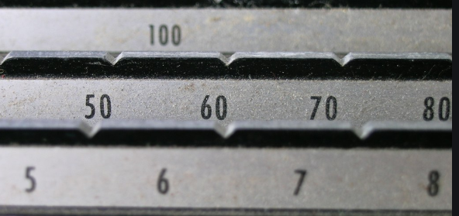
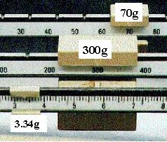
Reading A Triple Beam Balance
Slots
Important Note
Make sure the weights _____ _____ the slots
Do not slide weights __________ slots
Procedure
Adjust the ______g weight first
Adjust he ______g weight second
Fine _________ the zero pointer using the 1g weight
Use a pencil to help make ______ movements
Add up the sliding weights
The diagram shows a mass of
mass = ___________________
mass = _________

Slide 11
Recording Multiple Trials
We always repeat measurements at least __________ times
To ____________ measurement errors due to equipment
To look for ____________ (very high or very low measurements)
We calculate the average
Average = ____________________________________
Copy The following table & Calculate the average
Object | Trial 1 (± 0.1 g) | Trial 1 (± 0.1 g) | Trial 1 (± 0.1 g) | Average (± 0.1 g)
Object #1
Object #2

